Slide 1
maharashtra covid analysis story
File created on: 2/26/2022 5:27:29 PM

Slide 2
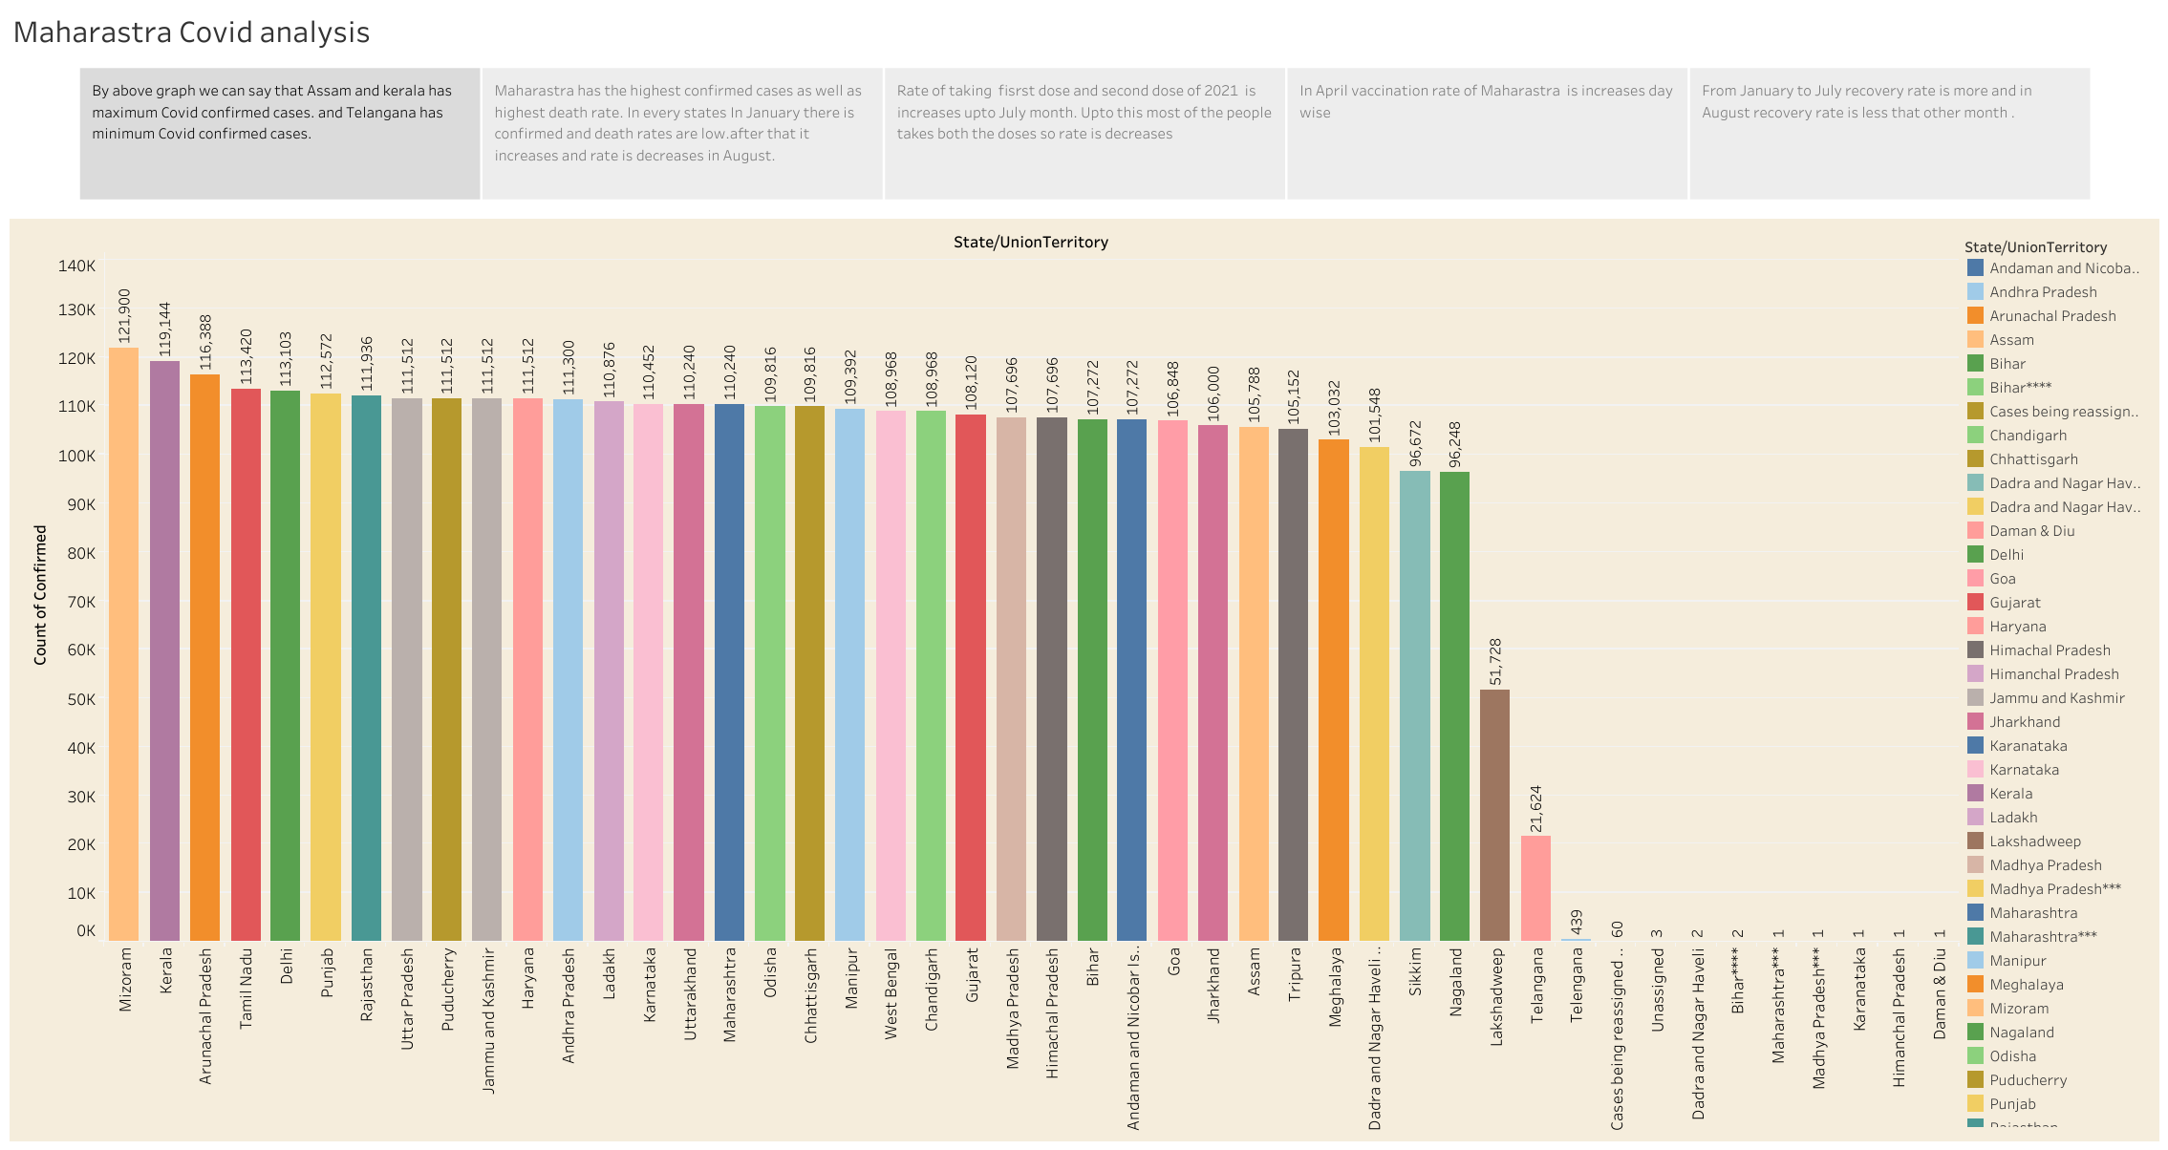

Slide 3
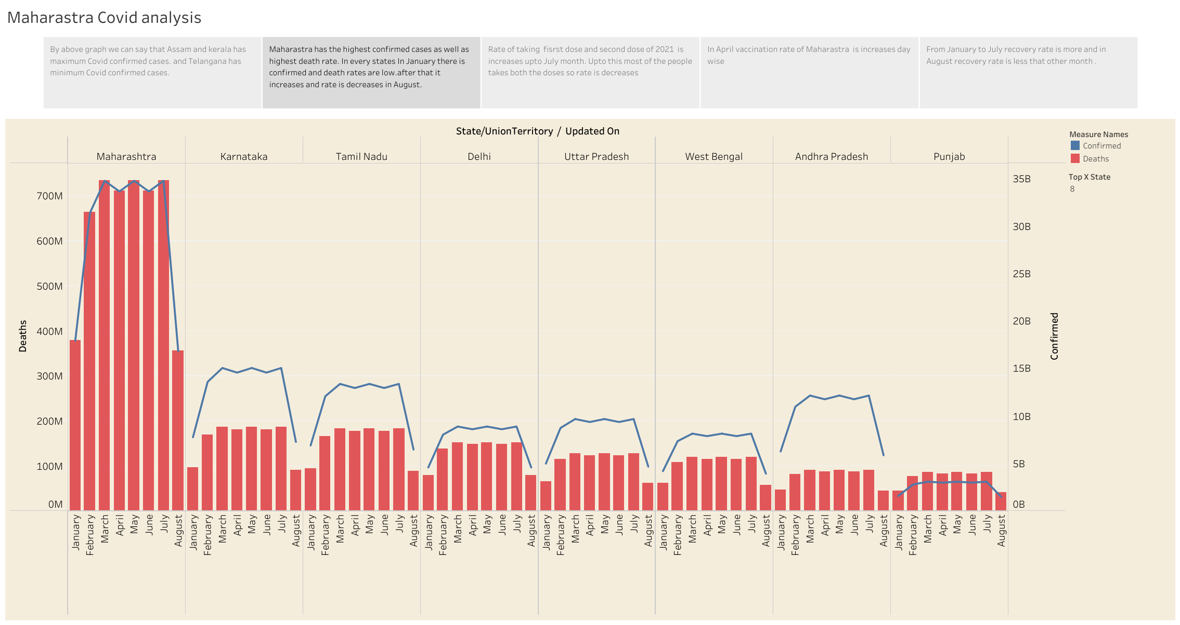

Slide 4
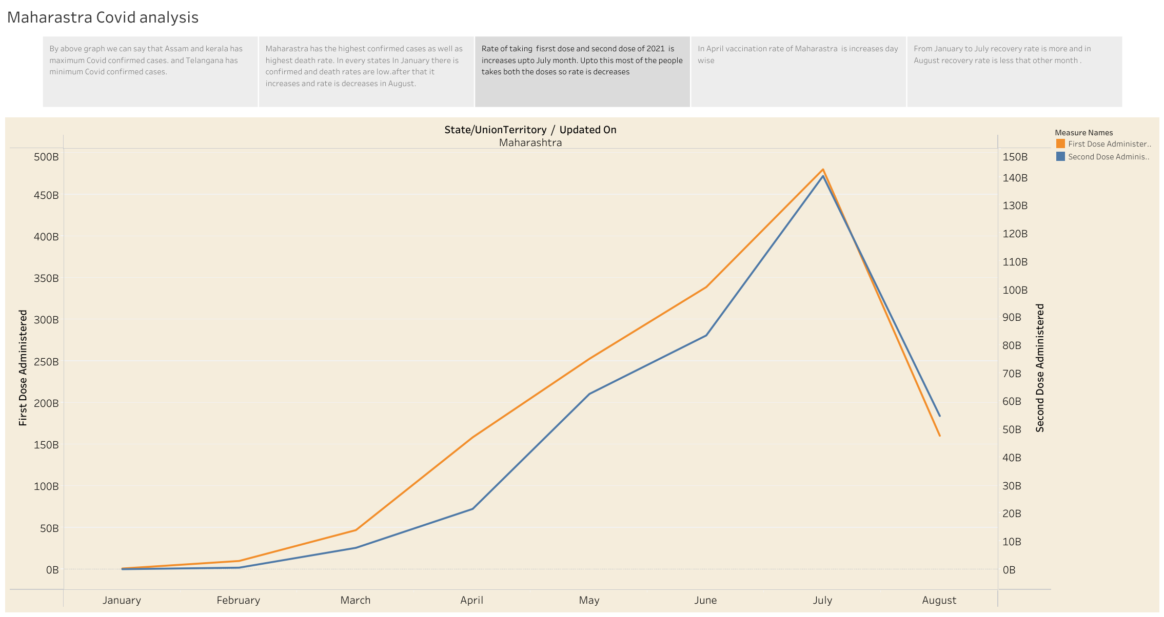

Slide 5
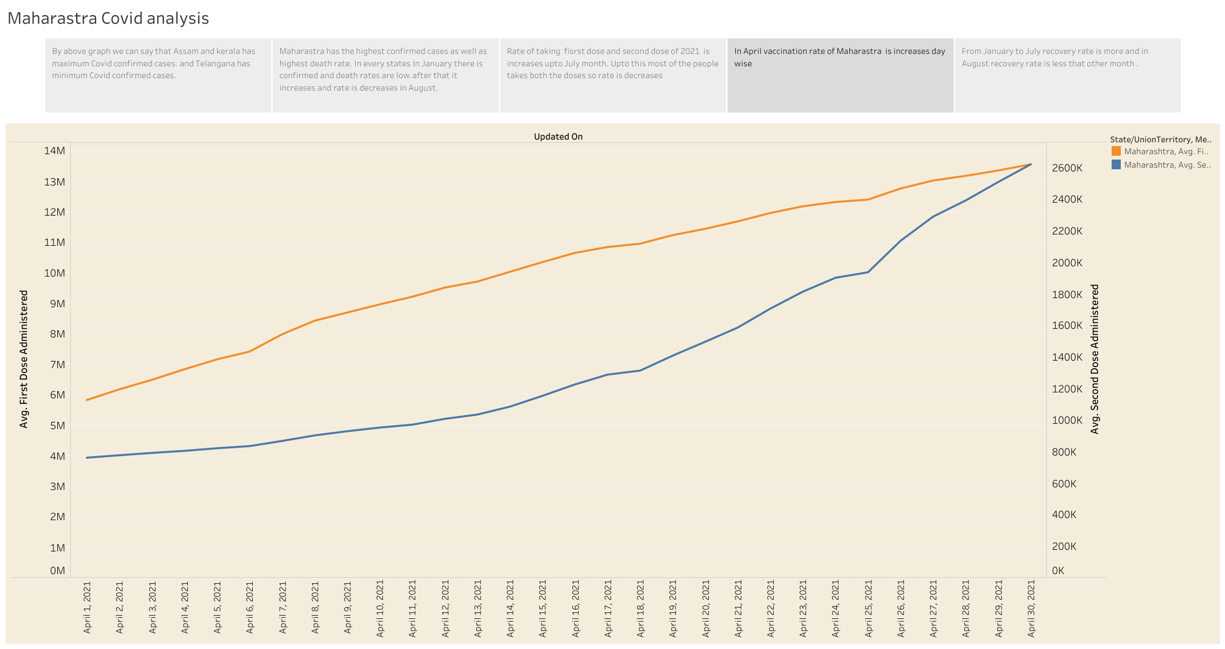

Slide 6
